Slide 1
Car number plate detection
By Abishek.R
RA2112039010002

Slide 2
Objective
The main objective of this project is to detect the number plates which consists of the registration number of each vehicles using deep learning.

Slide 3
Dataset description:
The dataset is taken from the Kaggle.
It has various images of the number plates of the different cars.
It also has the annotations of the cars.

Slide 4
Algorithm used:
VGG16 is a simple and widely used Convolutional Neural Network (CNN) Architecture used for ImageNet, a large visual database project used in visual object recognition software research. The VGG16 Architecture was developed and introduced by Karen Simonyan and Andrew Zisserman from the University of Oxford, in the year 2014, through their article “Very Deep Convolutional Networks for Large-Scale Image Recognition.” ‘VGG’ is the abbreviation for Visual Geometry Group, which is a group of researchers at the University of Oxford who developed this architecture, and ‘16’ implies that this architecture has 16 layers (explained later).

Slide 5
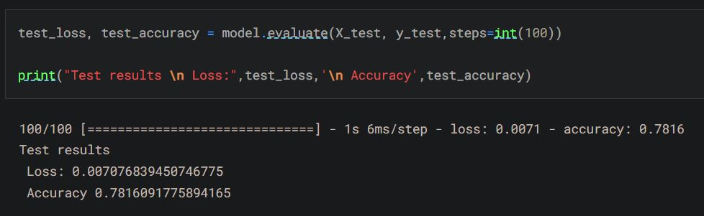
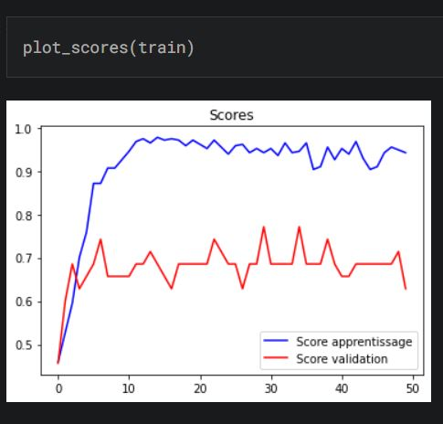
Accuracy and results:
The accuracy obtained from the trained neural network model tends to be 78% and loss is obtained to be 0.0071 which is pretty good for an OCR module.

